Slide 1
Computer graphics sec7
DR. Heba ElHadidi
Eng. Sahar Magdy

Slide 2
Libraries
Graphics
Turtle
Open GL

Slide 3
Functions of dealing with lighting
Function | Job
glEnable(GL_LIGHTING) | Activates the lighting system in OpenGL.
glEnable(GL_LIGHT0,…., GL_LIGHT7) | Activate the light source.
glLightfv(light source, GL_AMBIENT or GL_POSITION or GL_DIFFUSE, [x, y, z, w]) | x, y, z represent the direction or position of light w = 0 or 1 determines the type of light w = 1 → point light w = 0 → directional light

Slide 4
Time and modification functions
Function | Job
glutTimerFunc(num of milliseconds, name_function, 0) | This function modifies the function that is selected after a specified period of time.
glutPostRedisplay() | Redraw the screen.

Slide 5
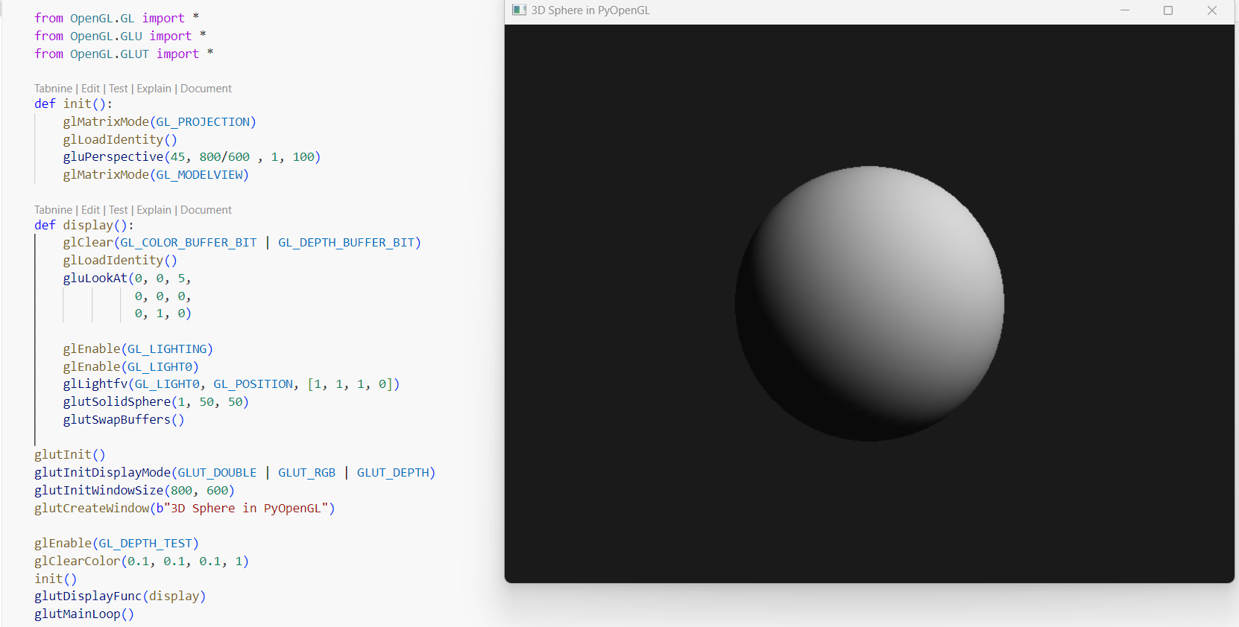

Slide 6
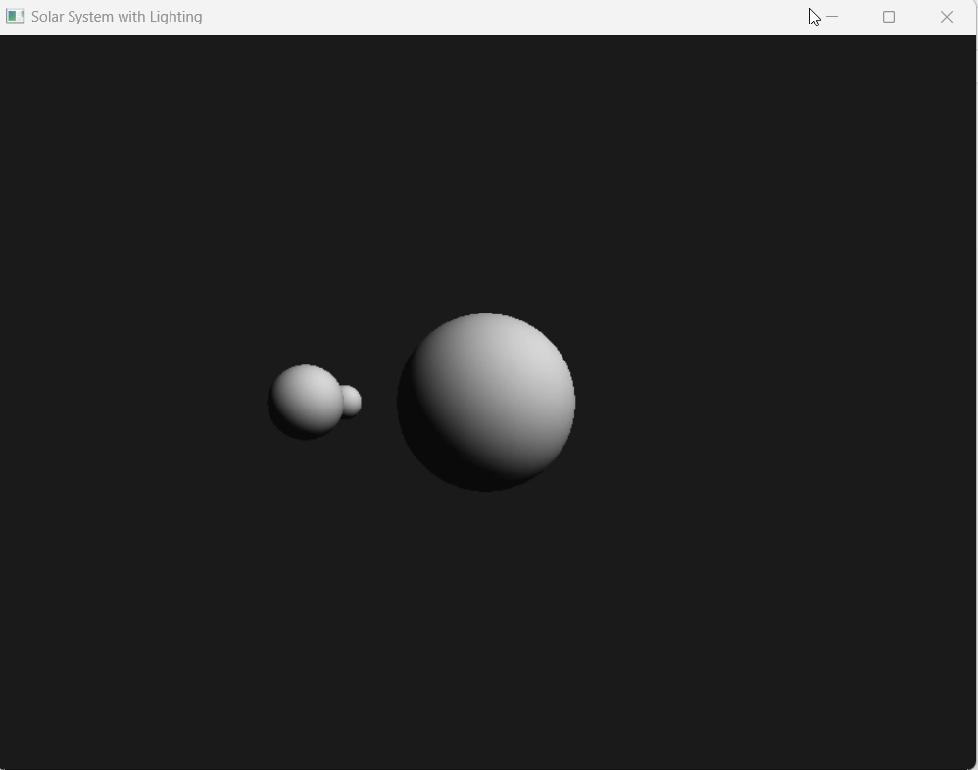

Slide 7
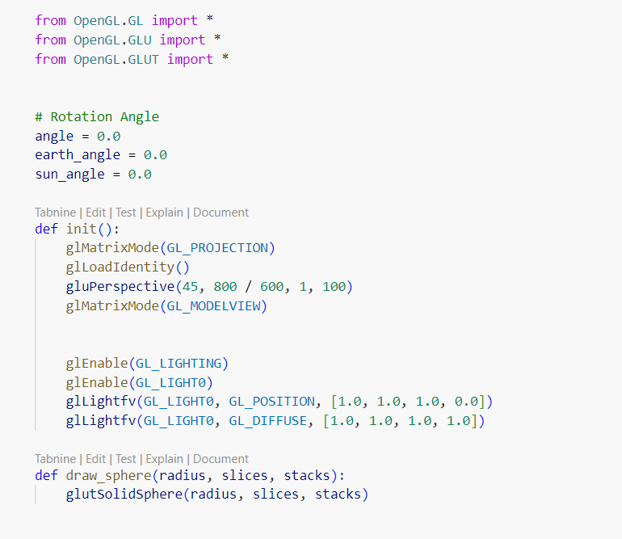

Slide 8
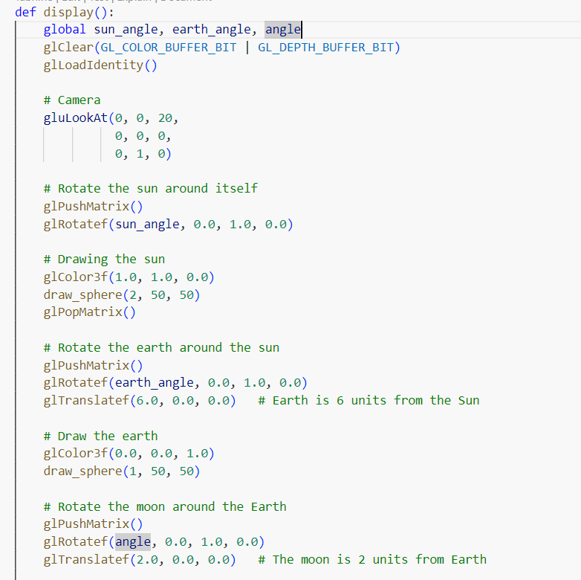

Slide 9
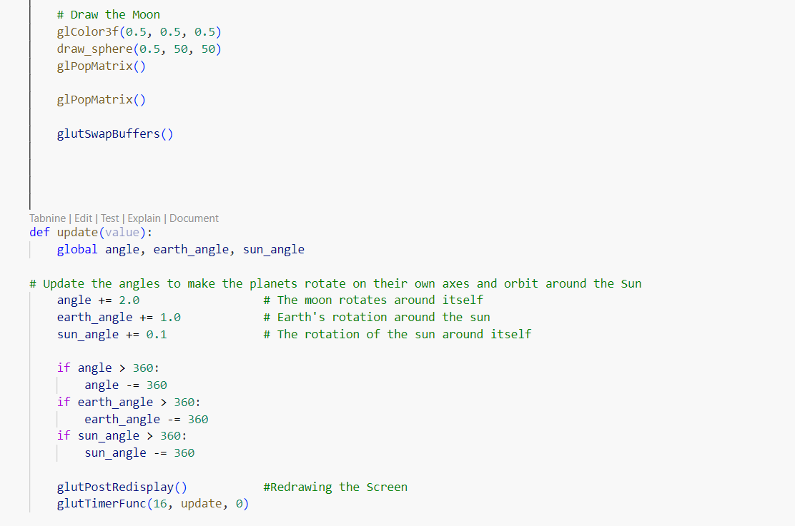

Slide 10
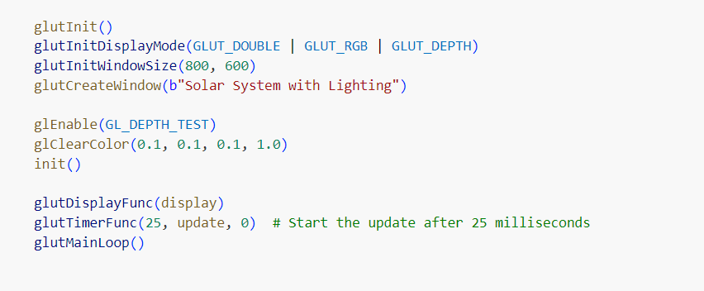

Slide 11
Task

Slide 12
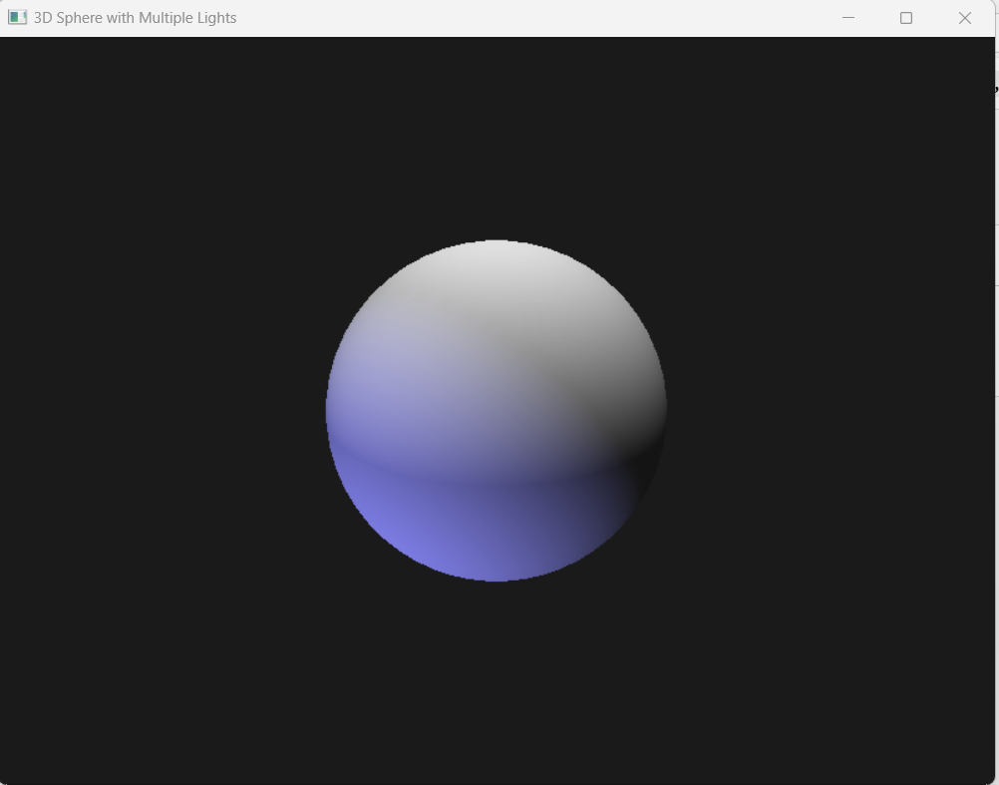


Slide 13
THANK YOU

